Slide 1
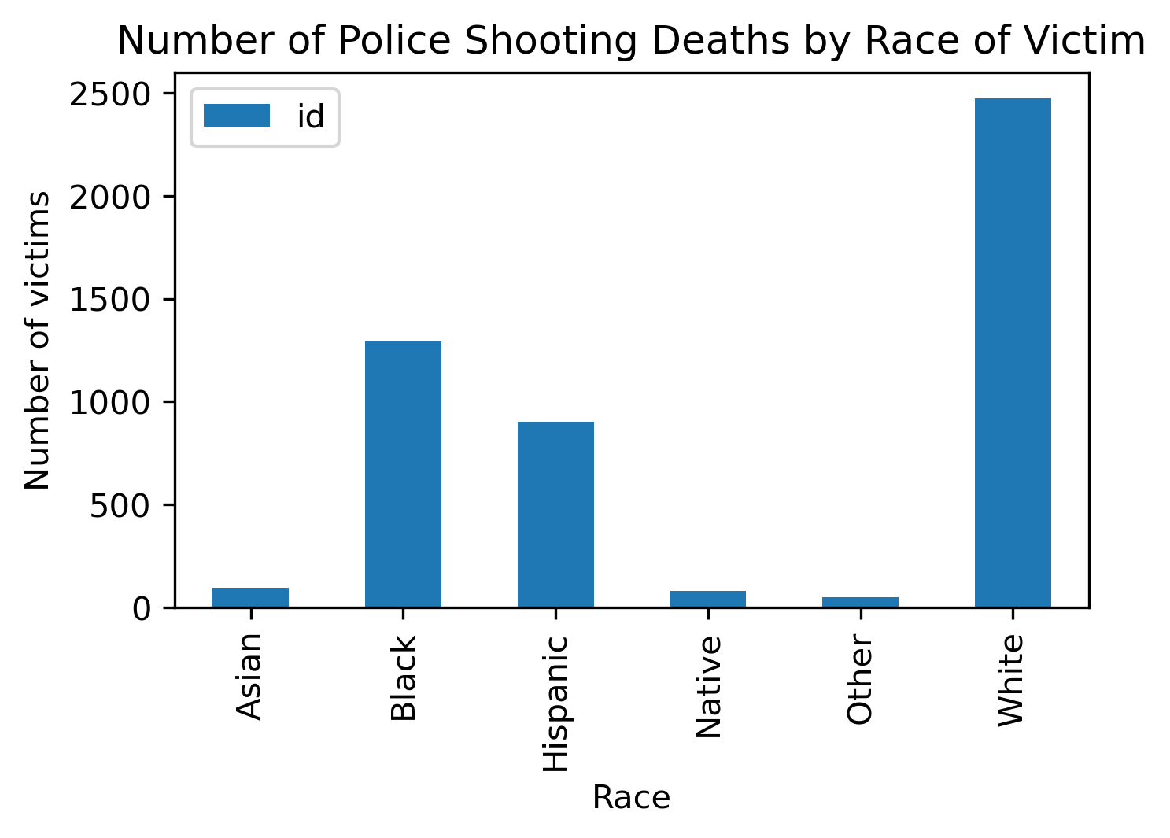
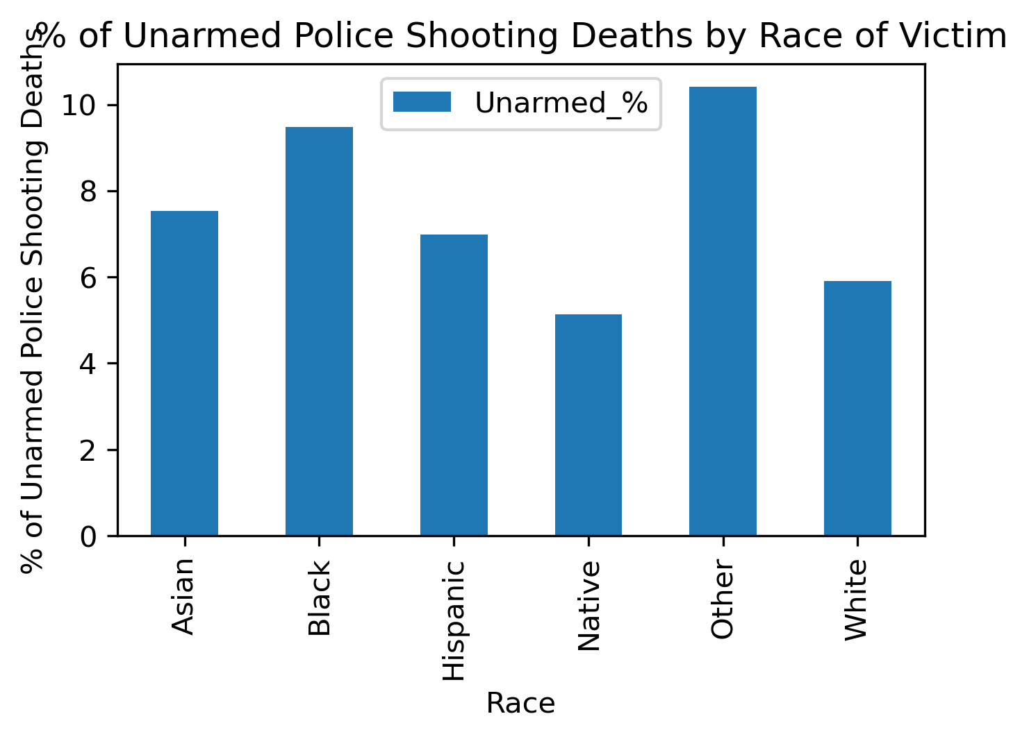
Police shootings by Race
Chi Squared Value = 5702.8
Critical Value = 11.1
Chi Squared Value = 350.3
Critical Value = 11.1

Slide 2
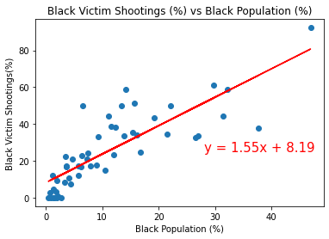
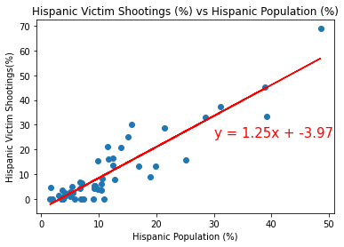
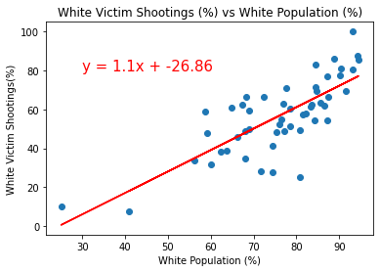
Shooting Victims by race vs Population % by race
R Value = 0.82
R squared = 0.67
p-value = 1.62e-13
R Value = 0.91
R squared = 0.83
p-value = 9.36e-21
R Value = 0.77
R squared = 0.59
p-value = 3.67e-11

Slide 3
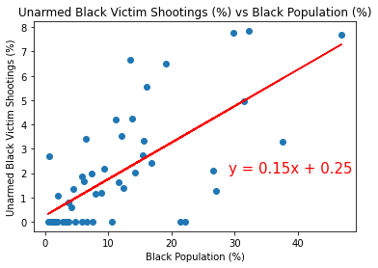
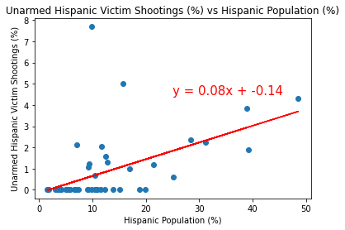
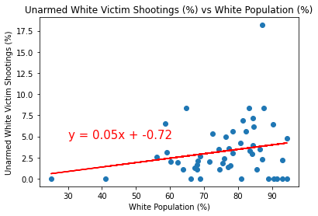
Unarmed Shooting Victims by race vs Population % by race
R Value = 0.69
R squared = 0.48
p-value = 1.74e-8
R Value = 0.52
R squared = 0.27
p-value = 7.74e-5
R Value = 0.22
R squared = 0.05
p-value = 0.12

Slide 4
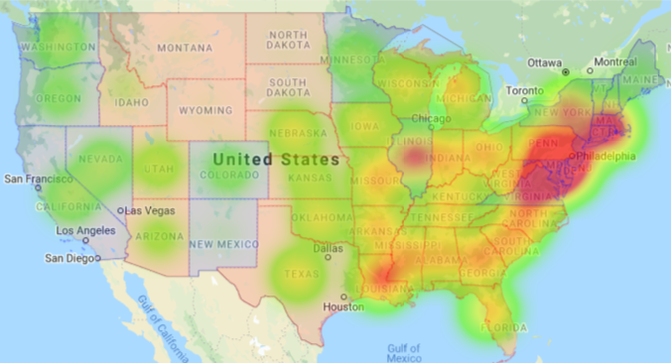
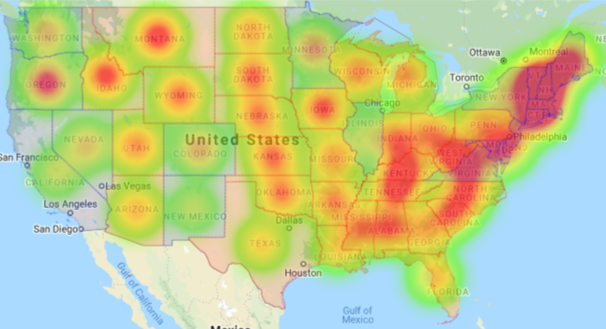
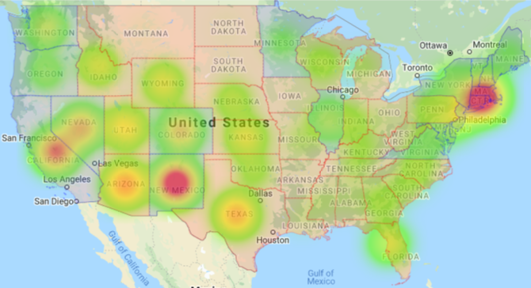
Unarmed Shooting Victims by race vs Population % by race
Black Victims Shootings %
White Victims Shootings %
Hispanic Victims Shootings %

